Slide 1


BDD with Cucumber & Java
www.snapbytes.com

Slide 2
Introduction to Acceptance Testing
1

Slide 3
Introduction
Unit Test
Integration Test
Regression Test
Acceptance Test

Slide 4
Unit Testing
You test each individual piece of code.
In java this means you are testing a single class.
Usually done by the developers.
If the unit depends on other units they are faked (mocked).
Often automated but it can also be done manually.

Slide 5
Integration Testing
Individual software modules are combined and tested as a group.
You test the integrations of many units together.
You make sure your code works when put together, including dependencies, databases and libraries.
Usually done by the developers.

Slide 6
Regression Testing
Ensure that further changes have not broken any units that were already tested.
Ensure that specific bug will not occur again. (Assume a test that was written when a bug was fixed)
Make sure the application provides the same outcome
Running unit/integration tests with every commit is technically (automated) regression testing

Slide 7
Acceptance Test
Ensure a feature or use case meets user/customer/business requirements.
Check that the entire system (or a subsystem) fulfils its entire specifications.
Mainly run before finishing a new deliverable or announcing completion of a larger task.
It can be done manually by user/tester or automatically by testing tools such as Cucumber and Selenium.

Slide 8
Summary
When fails | It tells you that
Unit Test | what piece of your code needs to be fixed
Integration Test | the pieces of your application are not working together as expected
Acceptance Test | the application is not doing what the customer expects it to do
Regression Test | the application no longer behaves the way it used to

Slide 9

Unit Test
99% of the unit tests pass

Slide 10
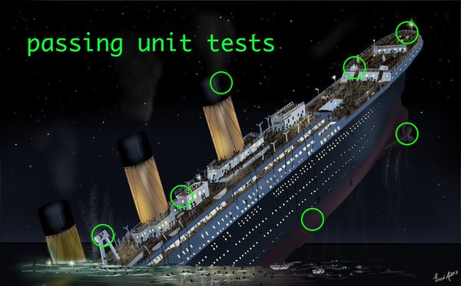
Unit Test

Slide 11




Unit Test/Integration Test
Unit Testing
Integration Testing

Slide 12

Acceptance Test
Great for covering a lot of ground, but not so good for very specific things

Slide 13
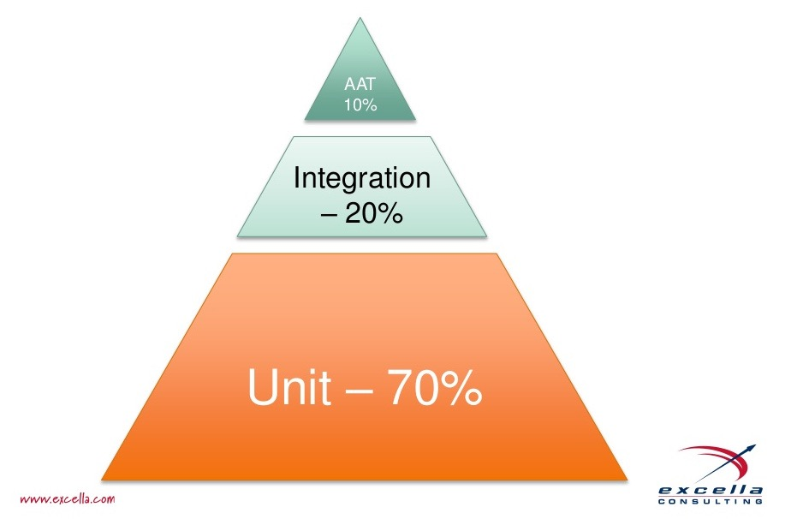
Pyramid
DEV team
Rapid feedback
Confidence in individual change
QA team
Cost
Running time
Slower feedback
Hard to maintain
Fragility
Confidence in entire system

Slide 14

What is Acceptance Testing
Functional / business level, not developer-facing
Even non-technical people can read
Doesn’t have to be automated to provide value

Slide 15
Why ?
Faster feedback
Reduce cost
Saves time
Improves quality
Proves that software behaves as expected

Slide 16
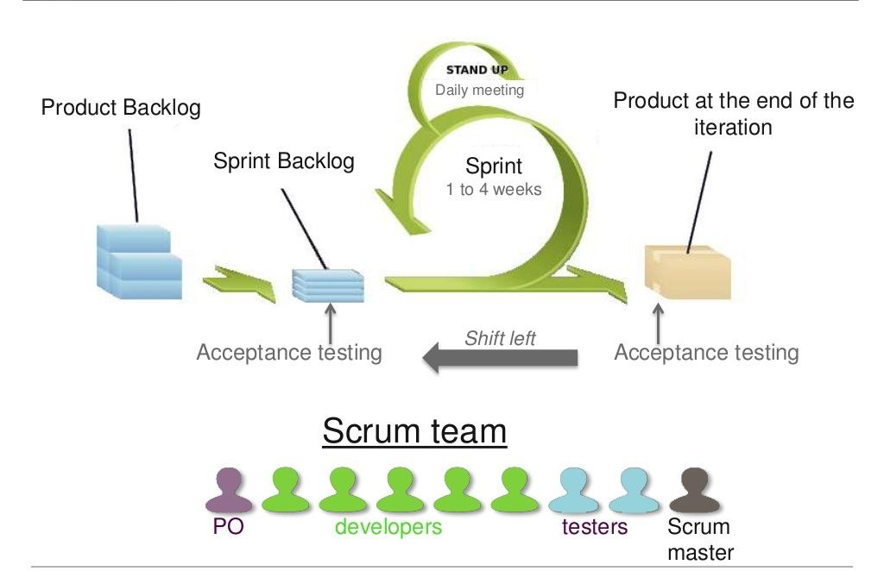
When ?

Slide 17
How ?
Analysts, testers and developers work together
User stories are turned into scenarios as executable specifications
Domain Driven Development
Behaviour Driven Development

Slide 18

Acceptance Test Layers
acceptance criteria
“Given …
When …
Then …”
test implementation layer
Domain Language
No ref to UI
application driver layer
Interact with application

Slide 19

Acceptance Criteria
Given some initial context,
When an event occurs,
Then there are some outcomes.
Scenario
Acceptance Criteria as Executable Specifications

Slide 20
Test Implementation Layer
Written in a host language (Ruby, Java, C#), but doesn't need to be the same as the system under test.
Often done as Domain Specific Language (DSL)
Cucumber: Regular expressions, Java, Ruby, .NET
Concordion: Written in HTML

Slide 21
Application Driver Layer
The only layer that understands how to talk to the application under test
Can be of any type: Desktop, Web, Console, REST, SOAP, ..
When UI of the application changes, this is the only part to be changed for Acceptance Test

Slide 22
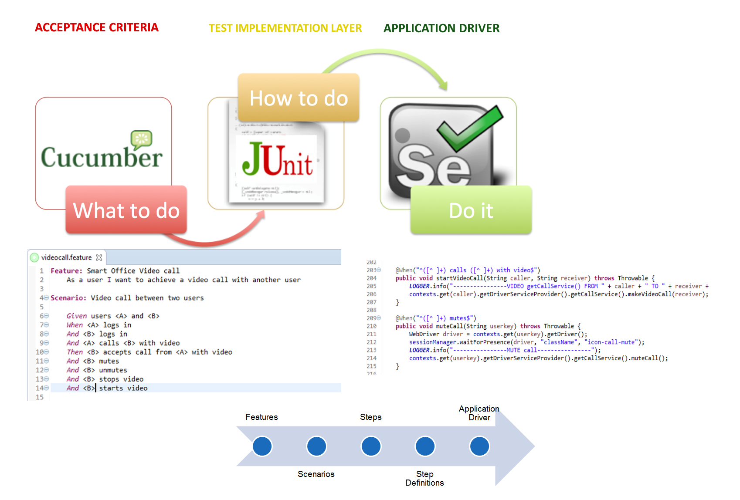
Acceptance Test Sample In NETAS

Slide 23


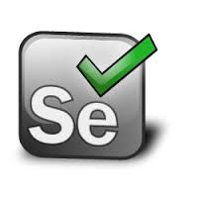


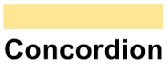
Some Frameworks

Slide 24
Introduction to Selenium Automation
2

Slide 25
What is Selenium?
Selenium automates browsers. That's it!
Uses browser mouse/key events
No OS interaction (not affected by)
Screen lock
OS Window focus
Almost full control of the browser with js

Slide 26

Selenium IDE
Quick bug reproduction scripts
Help scripts for exploratory testing
Record and Playback
Export to java, js, etc.

Slide 27
Selenium WebDriver
Browser regression scripts
Robust
Scalable
Multi-browser / multi-os

Slide 28
Selenium for Mobile
Appium (both iOS and Android)
Automation for iOS, Android, and Windows Apps.
Selendroid (Android)
“Selenium for Android”
facebook/WebDriverAgent (iOS)
A WebDriver server for iOS that runs inside the Simulator.

Slide 29
Selenium Alternatives
Cloud
ghostinspector.com, endtest.io, ...
Commercial
Micro Focus (Former HP, former Mercury) UFT/QTP
Silk Test
Katalon (free / closed source)
OSS
Robot FW, Watir, Sikuli, FitNesse
Specialized
UI testing: Screenster
Angular: Protractor

Slide 30
Introduction to BDD with Cucumber and Selenium
5

Slide 31
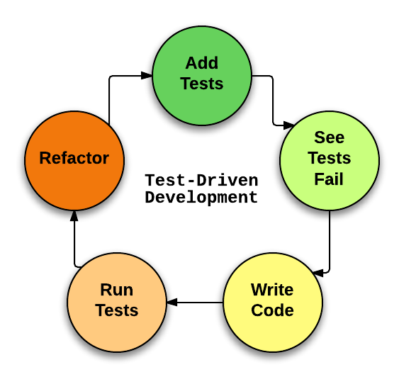
Flashback: TDD
Simply: Write tests before development

Slide 32
Behavior-Driven Development
Born in 2004
Hypothesis turned to Jbehave
Later, emerged tools like
RSpec
Cucumber
Behavior-Driven Development is like TDD where:
Principles are the same
Tests are “specifications of the product's behavior”
User Stories are executed like tests
And everyone can contribute by writing scenarios

Slide 33
Domain-Specific Language
Scenarios are written in a DSL
DSL:
A spoken-like language
Understandable(and writable) by many people
Not just programmers
Consists of Given-When-Then clauses

Slide 34
TDD vs. BDD
TDD:
Terms “tests” and “suite”
Aims to test software
Focused on results
Understandable by engineers
Written in programming language
BDD:
Terms “scenario and “feature”
Aims to design software
Focused on features
Understandable by all members of the team
Written in an English-like DSL

Slide 35
Cucumber
Tool to test BDD-style
First implemented in Ruby
Uses Gherkin language to define features/scenarios
Simple configuration
Has Java implementation and a huge community
Has a simple cycle:
Write stories
Map steps into code(called glue code)
Run them
Supports and supported by many programming languages, IDEs and CI tools

Slide 36
Cucumber Implementations
Ruby/JRuby
JRuby (using Cucumber-JVM)
Java
Groovy
JavaScript
JavaScript (using Cucumber-JVM and Rhino)
Clojure
Gosu
Lua
.NET (using SpecFlow)
PHP (using Behat)
Jython
C++
Tcl
Ruby on Rails
Selenium
PicoContainer
Spring Framework
Watir
Serenity

Slide 37
Java Implementation
StepDefinition.java:
package foo; public class MyStepdefs { @Given("I have (\\d+) cukes in my belly") public void I_have_cukes_in_my_belly(int cukes) { System.out.format("Cukes: %n\n", cukes); } }
Cuke.feature:
Scenario: Some cukes Given I have 48 cukes in my belly

Slide 38
Feature/Scenario/Background Example
Feature: Multiple site support Background: Given a global administrator named "Greg" And a blog named "Greg's anti-tax rants" And a customer named "Dr. Bill" And a blog named "Expensive Therapy" owned by "Dr. Bill" Scenario: Dr. Bill posts to his own blog Given I am logged in as Dr. Bill When I try to post to "Expensive Therapy" Then I should see "Your article was published."

Slide 39
And/But Example
Scenario: Multiple Givens Given one thing And another thing And yet another thing When I open my eyes Then I see something But I don't see something else

Slide 40
Scenario Outline Example
Scenario Outline: eating Given there are <start> cucumbers When I eat <eat> cucumbers Then I should have <left> cucumbers Examples: | start | eat | left | | 12 | 5 | 7 | | 20 | 5 | 15 |

Slide 41
Common Hook Usages
Before:
Starting a webdriver
Setting up DB connections
Setting up test data
Setting up browser cookies
Navigating to certain page
After:
Killing the webdriver
Closing DB connections
Clearing the test data
Clearing browser cookies
Logging out from the application
Printing reports or logs
Taking screenshots on error

Slide 42
Scenario Hook
Runs before and after scenarios
@Before public void beforeScenario() { System.out.println("This will run before the Scenario"); } @After public void afterScenario() { System.out.println("This will run after the Scenario"); }

Slide 43
Step Definitions with Selenium
We want to implement web UI tests using BDD
Most common way: Selenium
Quick start:
Write scenarios in your language
Implement steps
Do not forget the driver
Run your scenarios
Enjoy the view ☺

Slide 44
Example Steps
Driver initialize and open page:
@Given("^User is on Home Page$")
public void user_is_on_Home_Page() throws Throwable {
driver = new FirefoxDriver();
driver.manage().timeouts().implicitlyWait(10, TimeUnit.SECONDS);
driver.get("http://www.store.demoqa.com");
}
Find element and navigate:
@When("^User Navigate to LogIn Page$")
public void user_Navigate_to_LogIn_Page() throws Throwable {
driver.findElement(By.xpath(".//*[@id='account']/a")).click();
}

